Slide 1
FAN PARTNERSHIP
SUMMIT 2025
Building Success Together

Slide 2

PEWIN-IAQ
LAUNCHED PRODUCTS

Slide 3

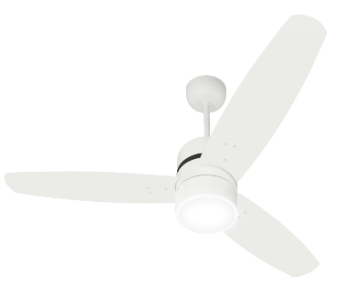
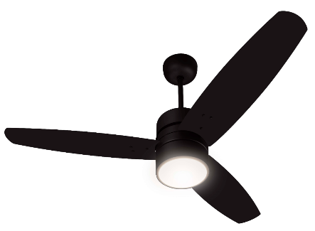

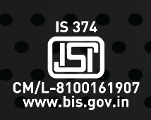
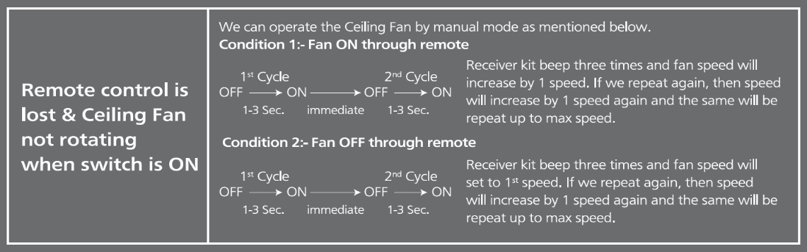

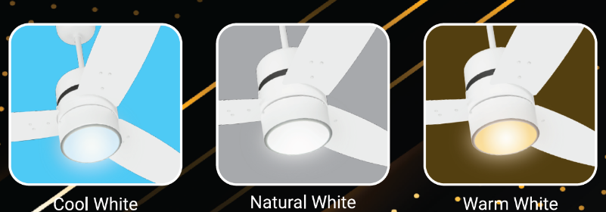
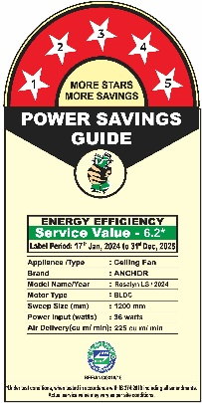

Rosalyn LS
.
Super Premium
Underlight BLDC Fan
FEATURES
Premium attractive glossy and matt finish for superior aesthetics
Remote control operation for LED & fan ON/OFF & 6 speed cont
With Timer (2/4/6/8 hour) & Sleep Mode in Remote
LED color: Cool white , Natural White, Warm White
Superior air delivery fan
BEE 5 star rating for energy saving
BIS Approved
Full RPM even at low voltage
Safety wire included
QR Code on Packing for Instruction Manual
BEE Label on Motor
Creame White
14218CWH
Choco Brown
14218CBR
RF Remote
Remote Loss Feature
Sweep (mm) | Speed (RPM) | Power (W) | Air Delivery (CMM) | Service Value (CMM/W) | Packing Type
1200 | 360 | 36 (Fan) (LED:20 W) | 225 | 6.2 | 1-in-1
For Environment & Health Protection
BEE Label & RoHS Sticker on Packing
(Motor Box, Blade Box & Shipper Box)

Slide 4

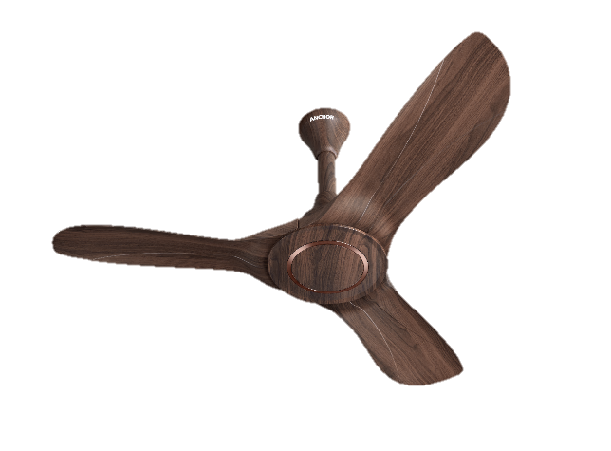

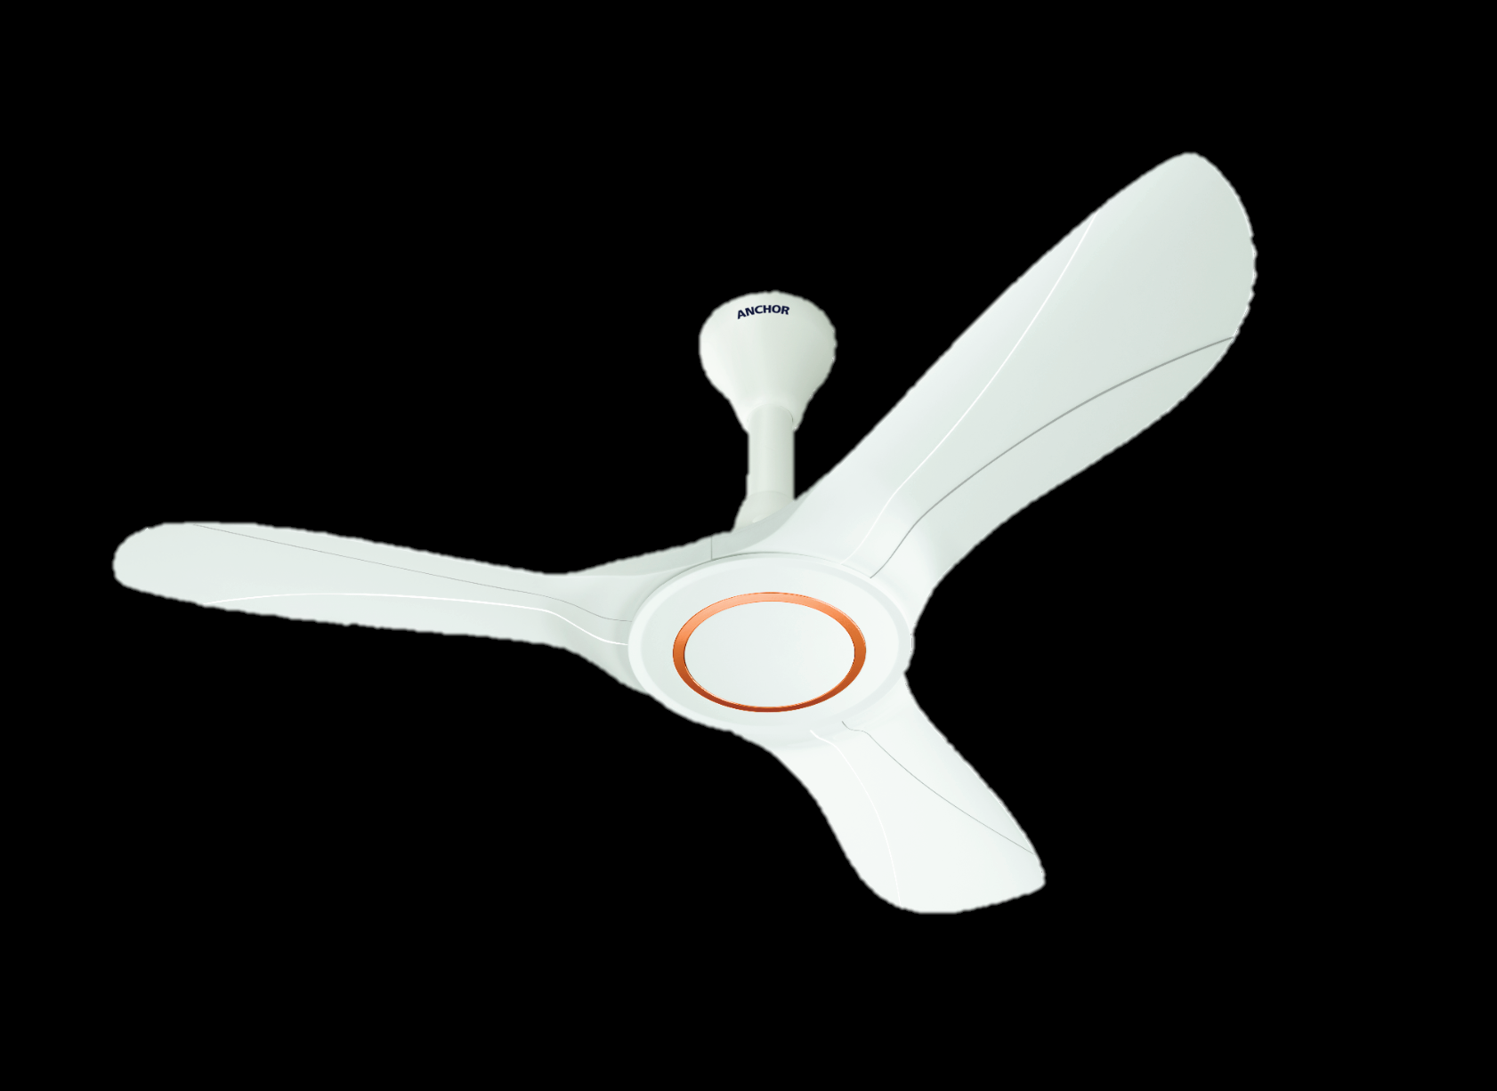
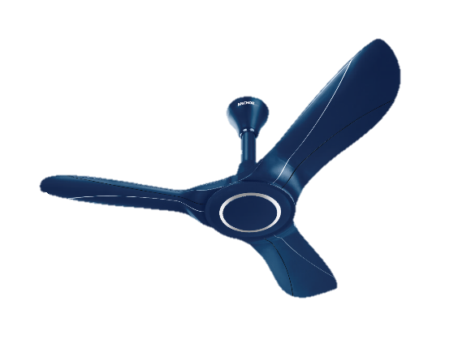
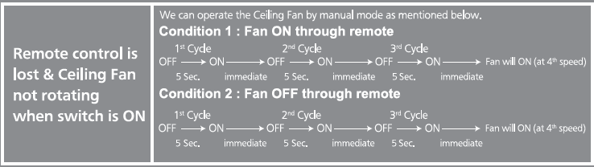

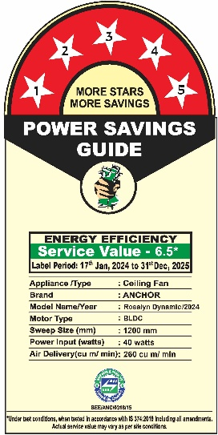


Rosalyn Dynamic
Super Premium
ABS + BLDC
FEATURES
Premium attractive Glossy finish & Wooden Texture for superior aesthetics
Plastic Blades are aerodynamically designed for Higher performance and lesser Sound Level
Remote control operation for fan ON/OFF & 5 speed control
Superior Air Delivery fan
BEE 5 star rating for energy saving
BIS Approved
Full RPM even at low voltage
Safety wire included
BEE Label on Motor
Dark Rich Wood
14227DRW
Glossy White
14227GWH
Pearl winter Blue
14227PWG
Remote Loss Feature
Sweep (mm) | Speed (RPM) | Power (W) | Air Delivery (CMM) | Service Value (CMM/W) | Packing Type
1200 | 270 | 40 | 260 | 6.5 | 1-in-1
RF Remote
For Environment & Health Protection
BEE Label & RoHS Sticker on Packing
(Motor Box, Blade Box & Shipper Box)

Slide 5

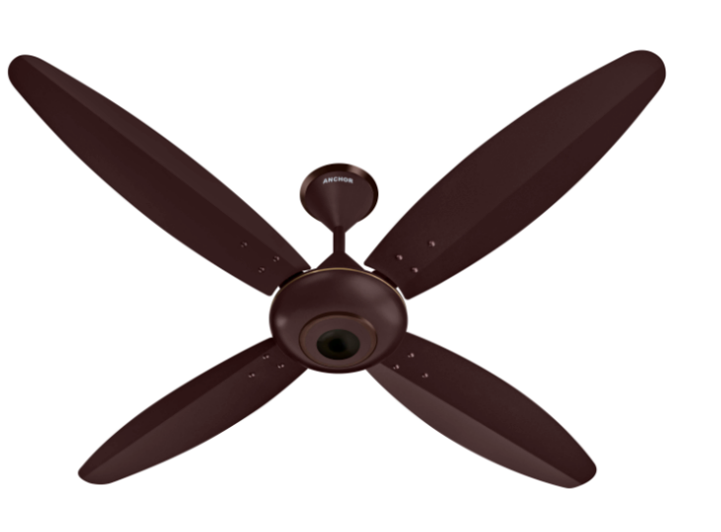
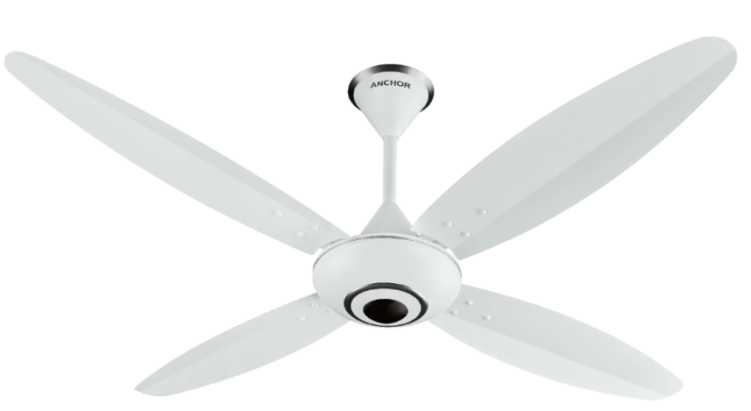
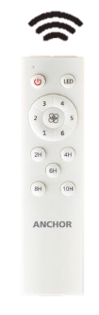
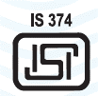

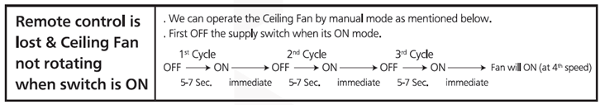
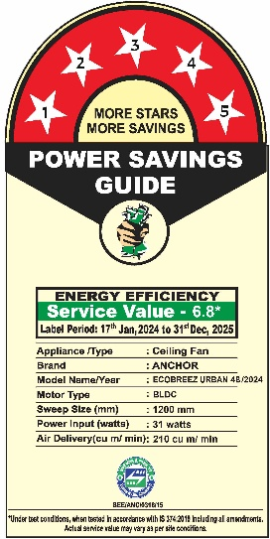
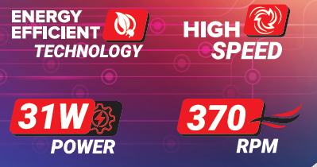
ECOBREEZ URBAN 4B
.
Super Premium
BEE 5 Star
FEATURES
Premium attractive colors with matt finish
Energy Efficient Fan
BEE Approved Five Star Rated for Energy Saving
Safety Wire Included
With Earthing provision on Shackle Kit for Extra Safety
BEE 5-star rating with 50% Energy saving
6 speed + Turbo speed control with 2-4-6-8-10 hrs. Auto OFF Function through remote
Remote Control Operation For LED, Fan ON/Off & Speed Control
Full RPM even at low voltage 130 V with super efficient noiseless motor
BEE Label on Motor
MOCHA
14142MCH
MATT WHITE
14142MWH
IR Remote
Sweep (mm) | Speed (RPM) | Power (W) | Air Delivery (CMM) | Service Value (CMM/W) | Packing Type
1200 | 370 | 31 | 210 | 6.8 | 2-in-1
For Environment & Health Protection
BEE Label & RoHS Sticker on Packing
(Motor Box, Blade Box & Shipper Box)

Slide 6

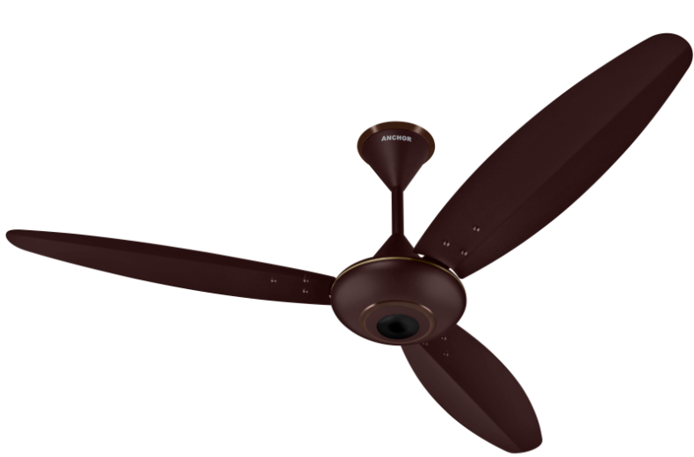
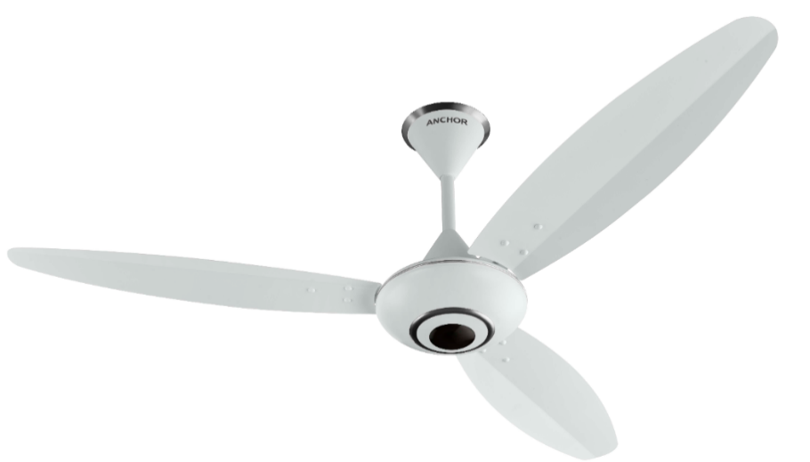

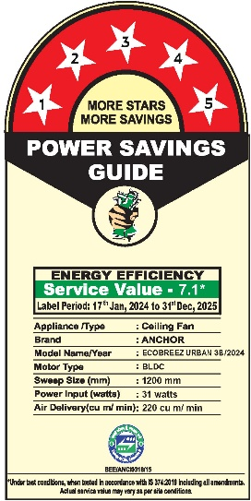
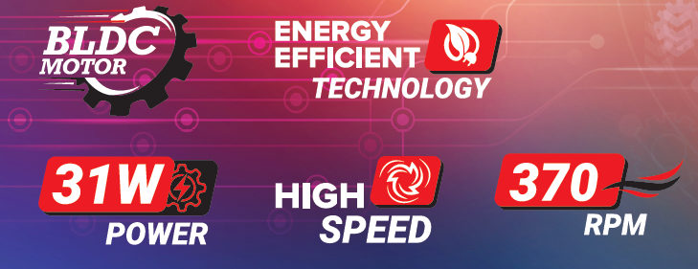
ECOBREEZ URBAN 3B
.
Super Premium
BEE 5 Star
FEATURES
Premium attractive colors with Matt Finish
Energy Efficient Fan
BEE Approved Five Star Rated for Energy Saving
With Earthing provision on Shackle Kit for Extra Safety
BEE 5-star rating with 50% Energy saving
6 speed + Turbo speed control with 2-4-6-8-10 hrs. Auto OFF Function through remote
Remote Control Operation For LED, Fan ON/Off & Speed Control
Full RPM even at low voltage 130 V with super efficient less noise motor
BEE Label on Motor
MOCHA
14143MCH
MATT WHITE
14143MWH
IR Remote
Sweep (mm) | Speed (RPM) | Power (W) | Air Delivery (CMM) | Service Value (CMM/W) | Packing Type
1200 | 370 | 31 | 220 | 7.1 | 2-in-1
For Environment & Health Protection
BEE Label & RoHS Sticker on Packing
(Motor Box, Blade Box & Shipper Box)

Slide 7


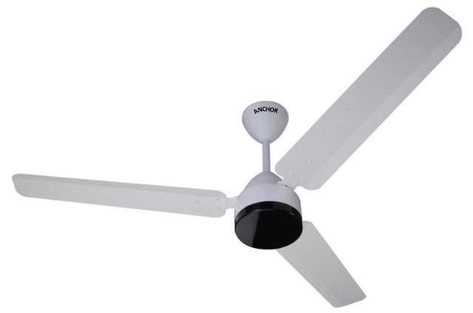
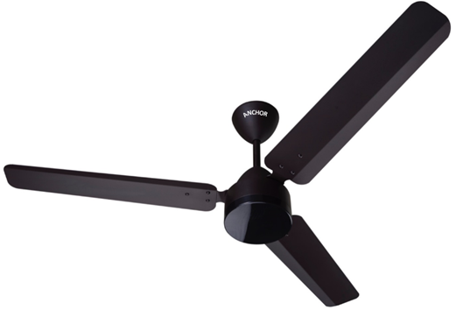
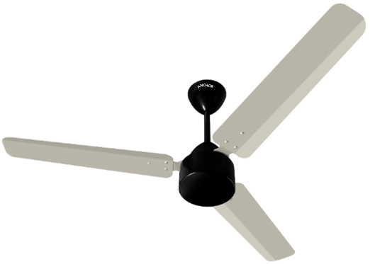
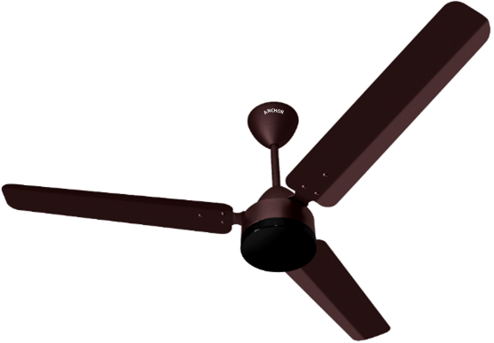



INSPIRIO
.
Standard
Compact Motor Dia
FEATURES
Attractive glossy & matt colors metallic coating
Energy Efficient Fan
BEE Approved Five Star Rated for Energy Saving
Safety Wire Included
5 speed & Eco Mode Through IR Remote
Remote Control Operation with 1/ 2/4/6/8 hrs. Auto OFF Function
Full RPM even at low voltage 130 V with super efficient noiseless motor
Black Plastic Bottom Housing
BEE Label on Motor
Product Code | Sweep (mm) | Speed (RPM) | Power (W) | Air Delivery (CMM) | Service Value (CMM/W) | Packing Type
14173CBR/LWH/SSL/EBR | 1200 | 350 | 30 | 215 | 7.2 | 3-in-1
14209CBR/LWH/SSL/EBR | 900 | 450 | 25 | 150 | 6.0 | 3-in-1
14228CBR/LWH/SSL/EBR | 600 | 800 | 25 | 110 | 4.4 | 6-in-1
IR Remote
For Environment & Health Protection

Slide 8

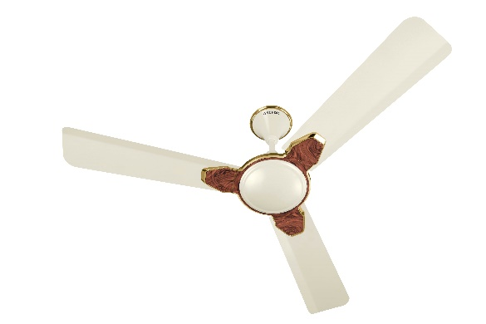
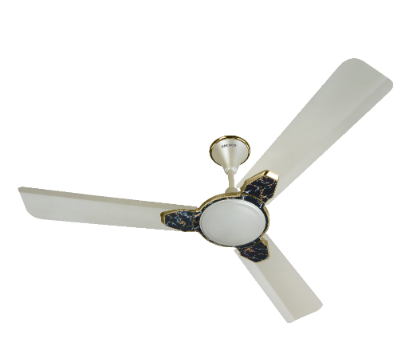
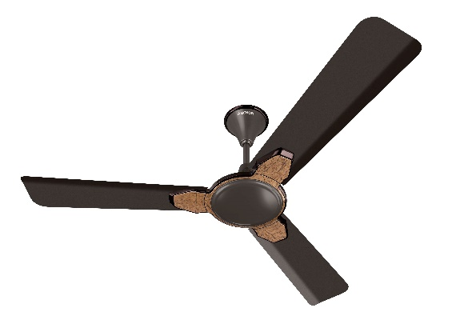
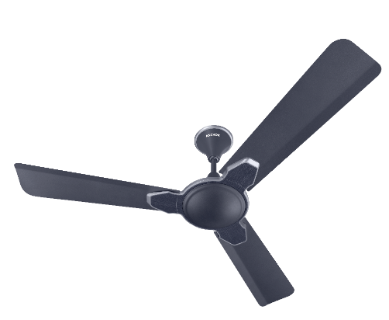
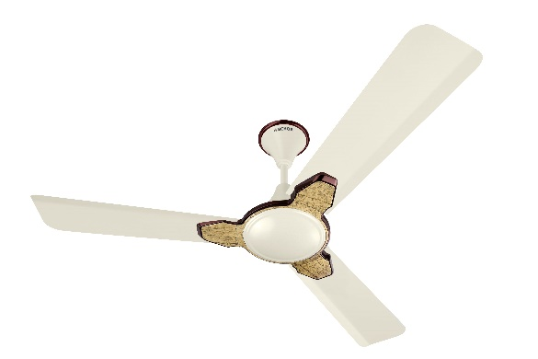
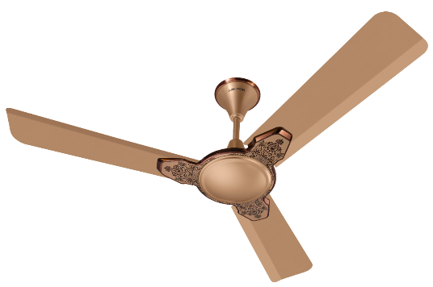
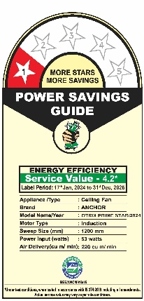

OTRIX PRIME STAR
.
Premium
BEE 1 Star
FEATURES
Premium attractive colors in Glossy and Matt finish
Energy Efficient Fan
BEE Approved One Star Rated for Energy Saving
Anti Dust technology for Easy dust cleaning
Service value 4.2
Unique trim & Body ring design for modern décor with Canopy ring
Safety Wire Included
With Earthing provision on Shackle Kit for Extra Safety
BEE Label on Motor
METALLIC IVORY WALNUT
14204MIW
AURUM INKY GOLD
14204AIG
FOLIAGE BROWN
14204FBR
FOLIAGE IVORY
14204FIV
GRAIN WOOD
14204GWD
HONEY GOLD BRIKEN
14204HGB
Sweep (mm) | Speed (RPM) | Power (W) | Air Delivery (CMM) | Service Value (CMM/W) | Packing Type
1200 | 400 | 53 | 220 | 4.2 | 2-in-1
For Environment & Health Protection
BEE Label & RoHS Sticker on Packing
(Motor Box, Blade Box & Shipper Box)

Slide 9
OTRIX PRIME STAR
.
Premium
BEE 1 Star
FEATURES
Premium attractive colors in Glossy and Matt finish
Energy Efficient Fan
BEE Approved One Star Rated for Energy Saving
Anti Dust technology for Easy dust cleaning
Service value 4.2
Unique trim & Body ring design for modern décor with Canopy ring
Safety Wire Included
With Earthing provision on Shackle Kit for Extra Safety
BEE Label on Motor
METALLIC IVORY WALNUT
14204MIW
AURUM INKY GOLD
14204AIG
HONEY GOLD BRIKEN
14204HGB
FOLIAGE BROWN
14204FBR
Sweep (mm) | Speed (RPM) | Power (W) | Air Delivery (CMM) | Service Value (CMM/W) | Packing Type
1200 | 400 | 53 | 220 | 4.2 | 2-in-1
For Environment & Health Protection
BEE Label & RoHS Sticker on Packing
(Motor Box, Blade Box & Shipper Box)

Slide 10

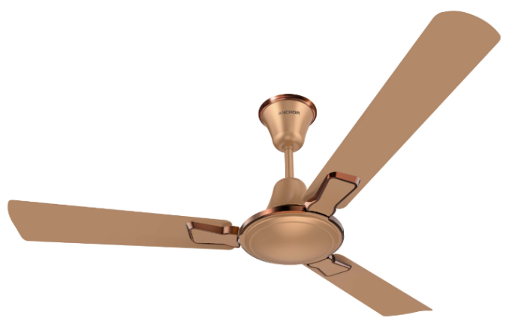
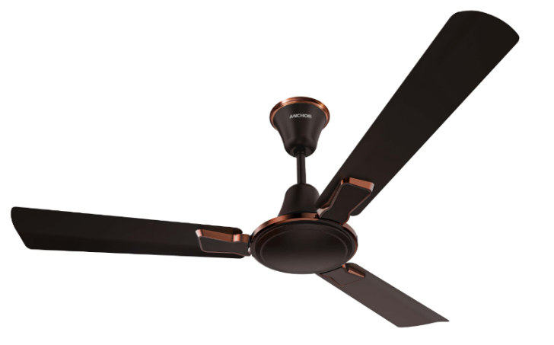
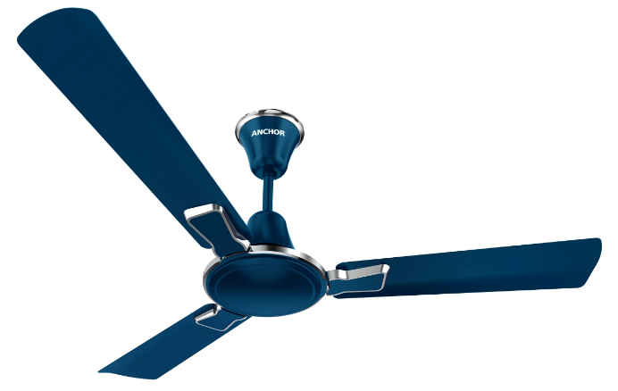


HARCON STAR
.
Premium
BEE 1 Star
FEATURES
Premium attractive colors with matt and glossy finish
Energy Efficient Fan
BEE Approved One Star Rated for Energy Saving
Anti Dust technology for Easy dust cleaning.
Service value 4.1
Unique trim, Body ring & Canopy ring design for modern décor
Safety Wire Included
With Earthing provision on Shackle Kit for Extra Safety
BEE Label on Motor
HONEY GOLD BRIKEN
14194HGB
CHOCO BROWN COPPER
14194CBC
PEARL WINTER BLUE
14194PWB
Sweep (mm) | Speed (RPM) | Power (W) | Air Delivery (CMM) | Service Value (CMM/W) | Packing Type
1200 | 400 | 54 | 220 | 4.1 | 2-in-1
For Environment & Health Protection
BEE Label & RoHS Sticker on Packing
(Motor Box, Blade Box & Shipper Box)

Slide 11

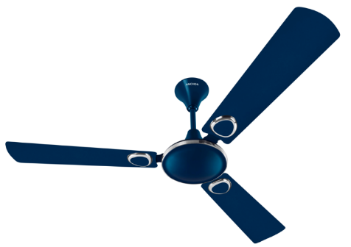
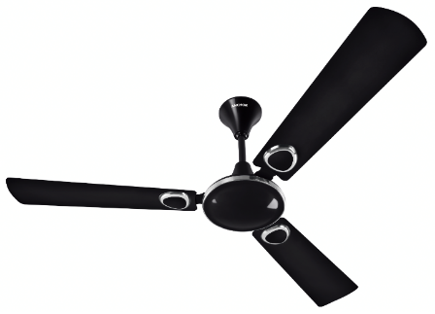
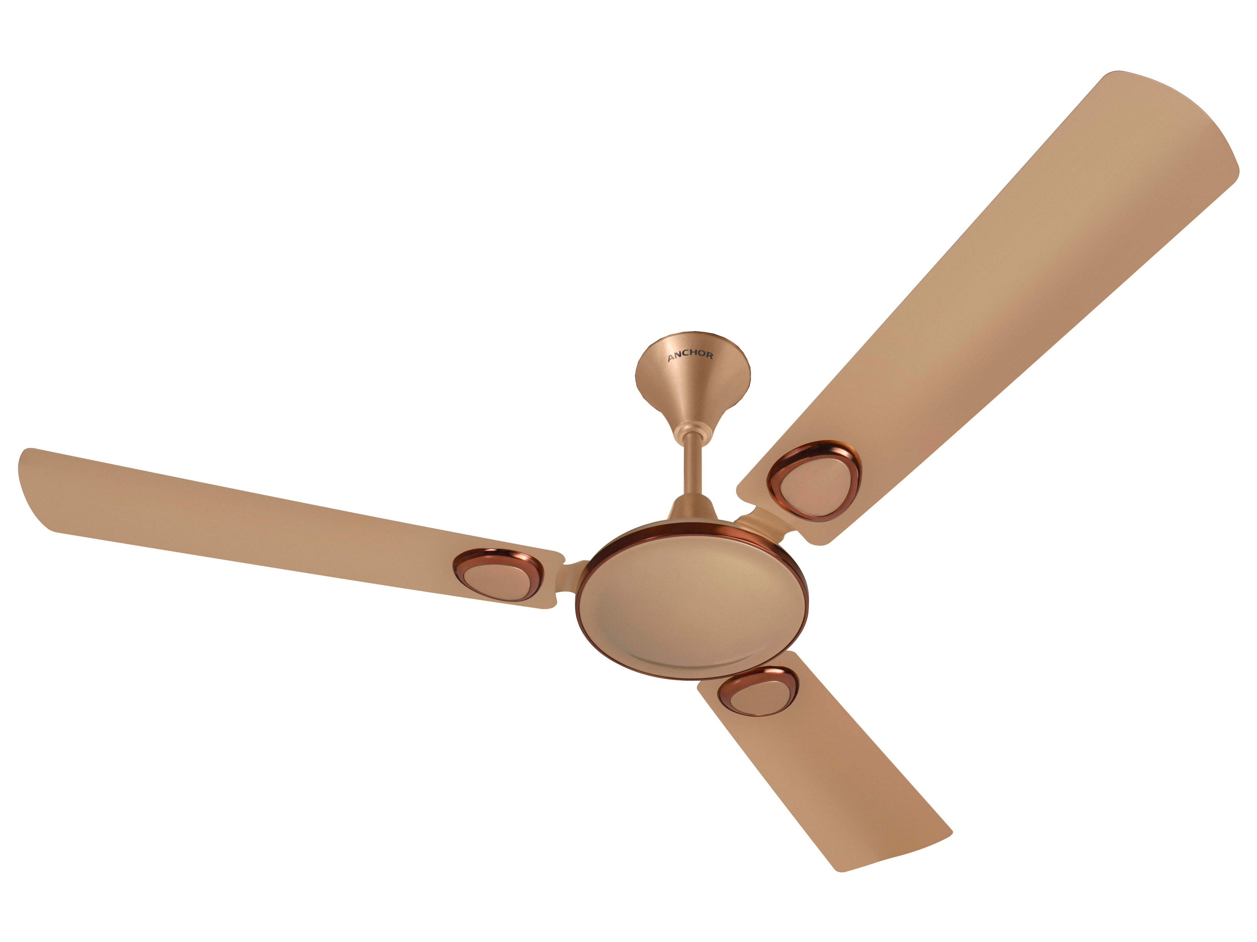

CRUZE URBAN STAR
.
DECORATIVE
BEE 1 Star
FEATURES
Premium attractive glossy colors
Energy Efficient Fan
BEE Approved One Star Rated for Energy Saving
Anti Dust technology for Easy dust cleaning
Service value 4.2
Unique trim & Body ring design for modern décor
Safety Wire Included
With Earthing provision on Shackle Kit for Extra Safety
BEE Label on Motor
PEARL WINTER BLUE
14197PWB
VINTAGE BROWNY
14197VBR
HONEY GOLD BRIKEN
14197HGB
Sweep (mm) | Speed (RPM) | Power (W) | Air Delivery (CMM) | Service Value (CMM/W) | Packing Type
1200 | 400 | 53 | 220 | 4.2 | 4-in-1
For Environment & Health Protection
BEE Label & RoHS Sticker on Packing
(Motor Box, Blade Box & Shipper Box)

Slide 12

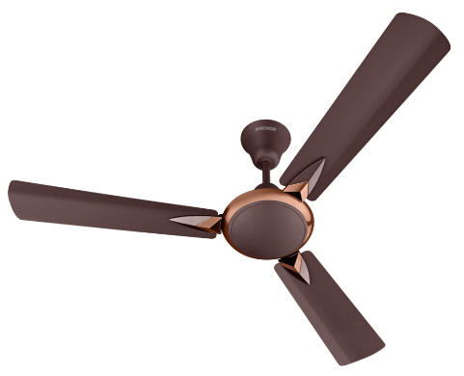
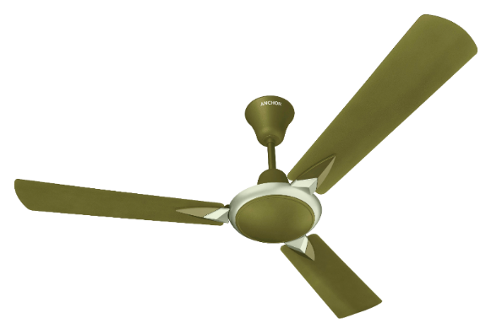
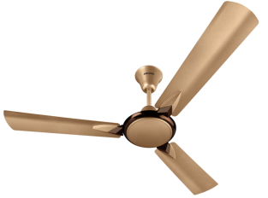

Sonora Dlx Star
.
Decorative
BEE 1 Star
FEATURES
Premium attractive matt & glossy metallic colors
Energy Efficient Fan
BEE Approved One Star Rated for Energy Saving
Anti Dust technology for Easy dust cleaning.
Unique trim & Bodyring design for modern décor
Safety Wire Included
With Earthing provision on Shackle Kit for Extra Safety
BEE Label on Motor
SOFT BROWN COPPER
14191SBC
14192SBC (900 mm)
MOSS GREEN
14191MGR
HONEY GOLD BRIKEN
14191HGB
Sweep (mm) | Speed (RPM) | Power (W) | Air Delivery (CMM) | Service Value (CMM/W) | Packing Type
1200 | 400 | 53 | 220 | 4.2 | 4-in-1
900 | 450 | 42 | 145 | 3.5 | 4-in-1
For Environment & Health Protection
BEE Label & RoHS Sticker on Packing
(Motor Box, Blade Box & Shipper Box)

Slide 13

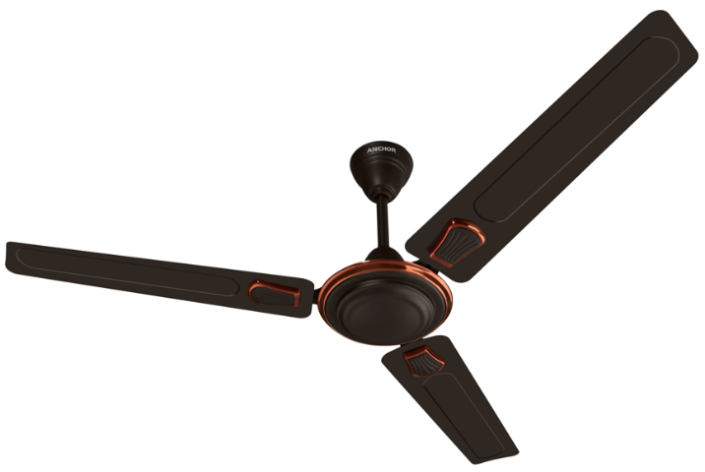
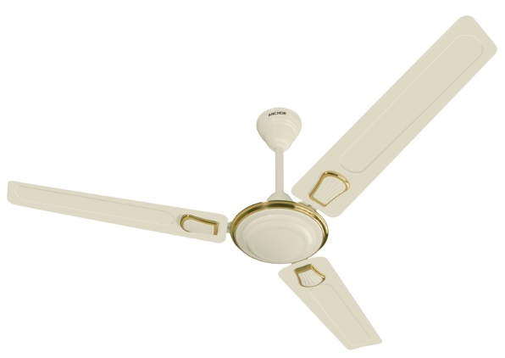


FINNAIR STAR
ECO DECORATIVE
BEE 1 Star
FEATURES
Energy Efficient Fan
BEE Approved One Star Rated for Energy Saving
Attractive matt & glossy colors, Fully powder coated for ever lasting Finish
With Earthing provision on Shackle Kit for Extra Safety
Unique trim & Body ring design for modern décor
BEE Label on Motor
SMOKE BROWN BRIKEN
14109SBB
IVORY GOLD
14109IGL
Sweep (mm) | Speed (RPM) | Power (W) | Air Delivery (CMM) | Service Value (CMM/W) | Packing Type
1200 | 390 | 50 | 210 | 4.2 | 4-in-1
900 | 450 | 40 | 140 | 3.5 | 4-in-1
For Environment & Health Protection
BEE Label & RoHS Sticker on Packing
(Motor Box, Blade Box & Shipper Box)

Slide 14

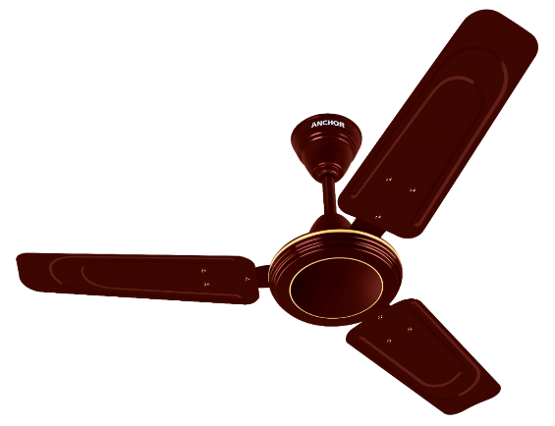
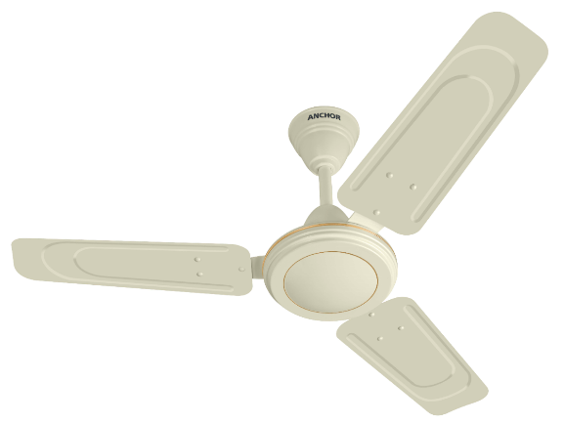
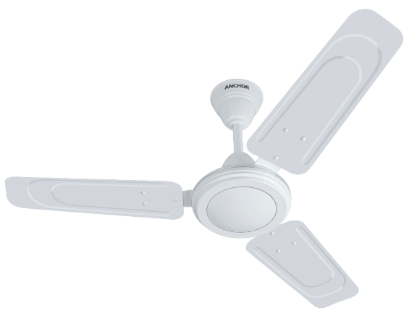



RAPIDO HS 900
.
ECO DECORATIVE
600 RPM
FEATURES
Attractive colors, fully powder coated for ever lasting finish
BEE Approved One Star Rated for Energy Saving
With Earthing provision on Shackle Kit for Extra Safety
600 RPM with High Air Delivery
BROWN
14200BR
IVORY
14200IV
WHITE
14200WH
Sweep (mm) | Speed (RPM) | Power (W) | Air Delivery (CMM) | Service Value (CMM/W) | Packing Type
900 | 600 | 52 | 165 | 3.2 | 4-in-1
For Environment & Health Protection
BEE Label & RoHS Sticker on Packing
(Motor Box, Blade Box & Shipper Box)

Slide 15

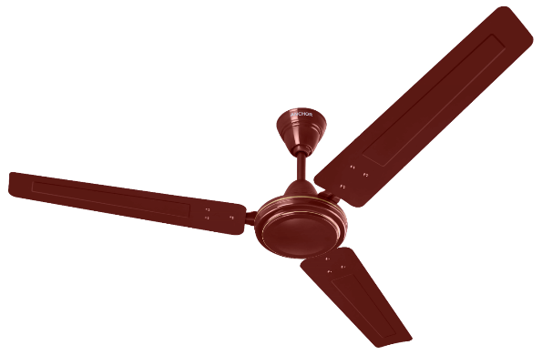
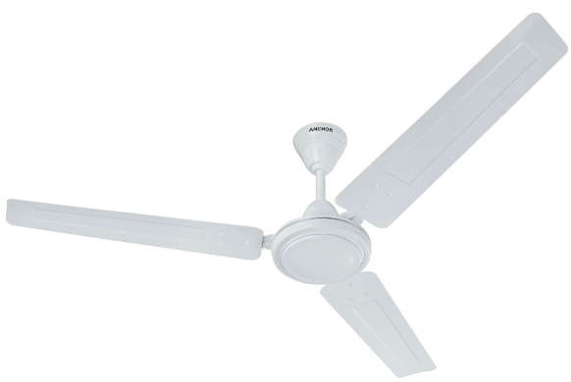
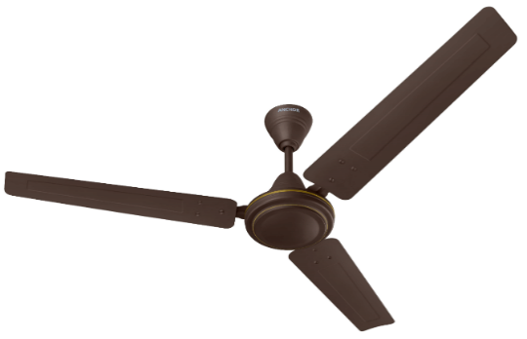


ALTRIX STAR
STANDARD
BEE 1 Star
FEATURES
Energy Efficient Fan
BEE Approved One Star Rated for Energy Saving
Attractive glossy & matt colors, Fully powder coated for everlasting Finish
With Earthing provision on Shackle Kit for Extra Safety
BEE Label on Motor
RUBY
LUSTER WHITE
COFFEE BROWN
PEARL WINTER BLUE
IVORY
Product Code | Sweep (mm) | Speed (RPM) | Power (W) | Air Delivery (CMM) | Service Value (CMM/W) | Packing Type
14185RB/LWH/IV/CBR/PWB | 1200 | 410 | 50 | 210 | 4.2 | 6-in-1
14186RB/LWH/IV/CBR | 900 | 440 | 45 | 143 | 3.2 | 6-in-1
14149RB/LWH/IV/CBR | 600 | 810 | 60 | 115 | 1.9 | 6-in-1
For Environment & Health Protection
BEE Label & RoHS Sticker on Packing
(Motor Box, Blade Box & Shipper Box)

Slide 16





COOLKING STAR
SUB ECONOMY
BEE 1 Star
FEATURES
Energy Efficient Fan
BEE Approved One Star Rated for Energy Saving
Attractive colors, Fully powder coated for ever lasting Finish
With Earthing provision on Shackle Kit for Extra Safety
BEE Label on Motor
BROWN
FG Code(1200 mm) : 14099BR
FG Code (1400 mm) : 14118BR
FG Code (900 mm) : 14117BR
IVORY
FG Code(1200 mm) : 14099IV
FG Code (1400 mm) : 14118IV
FG Code (900 mm) : 14117IV
Sweep (mm) | Speed (RPM) | Power (W) | Air Delivery (CMM) | Service Value (CMM/W) | Packing Type
1400 | 300 | 59 | 245 | 4.2 | 4-in-1
1200 | 390 | 50 | 210 | 4.2 | 4-IN-1
900 | 440 | 40 | 130 | 3.2 | 4-in-1
WHITE
FG Code(1200 mm) : 14099WH
FG Code (1400 mm) : 14118WH
FG Code (900 mm) : 14117WH
For Environment & Health Protection
BEE Label & RoHS Sticker on Packing
(Motor Box, Blade Box & Shipper Box)

Slide 17




Cooler Star
Sub Economy
BEE 1 Star
FEATURES
Energy Efficient Fan
BEE Approved One Star Rated for Energy Saving
Attractive colors , Fully powder coated for ever lasting Finish
With Earthing provision on Shackle Kit for Extra Safety
BEE Label on Motor
BROWN
WHITE
Sweep (mm) | Speed (Rpm) | Power (mm) | Air Delivery (CMM) | Service Value (CMM/W) | Packing Type
1200 | 390 | 50 | 210 | 4.2 | 4-in-1
IVORY
For Environment & Health Protection
BEE Label & RoHS Sticker on Packing
(Motor Box, Blade Box & Shipper Box)

Slide 18


ALTRIX HS
TPW - HS
Table Fan
FEATURES
Ability to withstand a wide range of voltages
Finger proof powder coated guards
Jerk Free & uniform Oscillation
Dynamically balanced blade for vibration free rotation
High speed fan for wider air spread
Aluminum body heavy duty motor
Thermal overload protector for extra safety
Sweep (mm) | Speed (RPM) | Power (W) | Air Delivery (CMM) | Packing Type
400 | 2200 | 115 | 95 | 1-in-1
ORAC WHITE
14168OWH
For Environment & Health Protection

Slide 19


ALTRIX HS
TPW - HS
WALL FAN
FEATURES
Ability to withstand a wide range of voltages
Finger proof powder coated guards
Jerk Free & uniform Oscillation
Pull cord control for speed and oscillation for wall fan
Dynamically balanced blade for vibration free rotation
High speed fan for wider air spread
Aluminium body heavy duty motor
Thermal overload protector for extra safety
ORAC WHITE
14166OWH/14167OWH
BLACK
14166BK (400 mm)
RED-BLACK
14166RBK/14167RBK
Sweep (mm) | Speed (RPM) | Power (W) | Air Delivery (CMM) | Packing Type
400 | 2200 | 115 | 95 | 1-in-1
300 | 2200 | 75 | 75 | 1-in-1
For Environment & Health Protection

Slide 20


ALTRIX HS
TPW - HS
Pedestal fan
FEATURES
Ability to withstand a wide range of voltages
Finger proof powder coated guards
Jerk Free & uniform Oscillation
Dynamically balanced blade for vibration free rotation
High speed fan for wider air spread
Aluminium body heavy duty motor
Thermal overload protector for extra safety
Fully adjustable height for a pedestal fan
Sweep (mm) | Speed (RPM) | Power (W) | Air Delivery (CMM) | Packing Type
400 | 2200 | 115 | 95 | 1-in-1
ORAC WHITE
14165OWH
RED-BLACK
14165RBK
For Environment & Health Protection

Slide 21



Penta Turbo
.
TPW - NS
Coming Soon……………
FEATURES
Aerodynamically balanced 5 PP Blades for low noise operation
Finger proof powder coated guards
Oscillation function brings wider range of air flow
Thermal overload protector for extra safety
Fully adjustable height for pedestal Fan
CRYSTAL WHITE GREY
14151CWG
CRYSTAL WHITE GREY
14152CWG
Sweep (In mm) | Speed (RPM) | Power (W) | Air Delivery (CMM) | Packing Type
400 | 1350 | 60 | 70 | 1-in-1
For Environment & Health Protection

Slide 22




Flora Neo
.
TPW - NS
Coming Soon……………
FEATURES
Aerodynamically balanced PP Blades for low noise operation
Dual Color Combination
Finger proof powder coated guards
Oscillation function brings wider range of air flow
Thermal overload protector for extra safety
Fully adjustable height for pedestal Fan
GRAPHITE GREY
14155GGY
GRAPHITE GREY
14154GGY
GRAPHITE GREY
14153GGY
Sweep (In mm) | Speed (RPM) | Power (W) | Air Delivery (CMM) | Packing Type
400 | 1350 | 60 | 70 | 1-in-1
For Environment & Health Protection

Slide 23




.
Farrata FP-03
Farrata
Additional Color
FEATURES
Durable Powder coated finish
Heavy duty motor for longer life
BIS Approved
Aerodynamic blades give high air thrust
Powerful motor for high air delivery even at low voltage
Vibration free operation
3-Speed rotary switch control
Height adjustable
Sweep (mm) | Speed (RPM) | Power (W) | Air Delivery (CMM) | Packing Type
500 | 1400 | 130 | 120 | 2-in-1 (Motor Packing) 1-in-1 (Accessories Packing)
14199BK
BLACK
14199GY
Grey

Slide 24


.
OPTIO MINI
Cabin Fan
FEATURES
Ideal for ceiling mount in low height areas.
Rotating Grill
High Speed Motor
Thermal fuse for extra safety
BIS Approved
WHITE
14092WH
Sweep (In mm) | Speed (RPM) | Power (W) | Air Delivery (CMM) | Packing Type
300 | 2350 | 70 | 61 | 4-in-1
For Environment & Health Protection

Slide 25


.
OPTIO MINI
Personal Fan
FEATURES
Portable & Light weight
Adjustable positioning.
Multi-purpose fan which can be used on Table or Wall
High Speed motor for good air delivery.
Thermal Overload Protector for safety
3 Speed Rotary switch control
BIS Approved
BLUE
14178BL
WHITE
14178WH
Sweep (In mm) | Speed (RPM) | Power (W) | Air Delivery (CMM) | Packing Type
230 | 2500 | 50 | 30 | 4-in-1
For Environment & Health Protection

Slide 26

Grestar
Grestar
.
Personal Fan
FEATURES
Portable & Light Weight
Manually Adjustable Angle
Multi- Purpose fan which can be used on a Table or Wall attractive dual tone design
High speed fan(3 Speed)
Sweep (mm) | Speed (RPM) | Power (W) | Air Delivery (CMM) | Packing
225 | 2500 | 50 | 28 | 3-in-1
GREY
14085GY
For Environment & Health Protection

Slide 27


.
MINEO
Personal Fan
FEATURES
High-speed motor.
Adjustable positioning.
Table mounted or Wall mounting
High Speed motor for good air delivery.
Thermal Fuse for extra Safety.
BIS Approved
BLUE
14002BU
GREY
14002GY
Sweep (In mm) | Speed (RPM) | Power (W) | Air Delivery (CMM) | Packing Type
230 | 2600 | 45 | 25 | 4-in-1
For Environment & Health Protection

Slide 28


SMART AIR
Plastic Exhaust
FEATURES
Rust proof Body & Blades
Self Opening Louvers
Light Weight
WHITE
BLACK
IVORY
Code | Sweep (mm) | Speed (RPM) | Power (W) | Air Delivery (CMH) | Packing Type
13979 WH/BK/IV | 150 | 1350 | 35 | 300 | 6-in-1
13980 WH/BK/IV | 200 | 1300 | 40 | 550 | 4-in-1
13981 WH/BK/IV | 250 | 1250 | 45 | 750 | 4-in-1

Slide 29


SMART AIR HIGH SPEED
Plastic Exhaust
FEATURES
Rust proof Body & Blades
Self Opening Louvers
Light Weight
WHITE
BLACK
BROWN
Code | Sweep (mm) | Speed (RPM) | Power (W) | Air Delivery (CMH) | Packing Type
14982WH/BK/BR | 150 | 2500 | 40 | 500 | 6-in-1
14983WH/BK/BR | 200 | 1900 | 60 | 765 | 4-in-1

Slide 30







SMART AIR COMPACT FIT
Plastic Exhaust
FEATURES
Rust proof Body & Blades
Self Opening Louvers
Light Weight
Back Frame with new Compatible Size
WHITE
14172WH
BLACK
14172BK
Existing |  |  |  | New
A | B | C |  | A | B | C
Sweep (mm) | Back Frame Size (L x B)mm | Wood Frame Size (L x B)mm |  | Sweep (mm) | Back Frame Size (L x B)mm | Wood Frame Size (L x B)mm
150 | 191 x 191 | 195 x 195 |  | 150 | 175 x 175 | 179 x 179
Sweep (mm) | Speed (RPM) | Power (W) | Air Delivery (CMH) | Packing Type
150 | 1350 | 35 | 300 | 6-in-1
SMART

Slide 31




ALTRIX HS-L
PLASTIC EXHAUST
EV with Light
FEATURES
Rust proof Body & Blades
Self Opening Louvers
Light Weight
Inbuilt LED light, enhance the decor and remove flying insects from room
WHITE
14184WH
Sweep (mm) | Speed (RPM) | Power (W) | Air Delivery (CMH) | Packing Type
200 | 1800 | 55 (only fan) 5W LED | 765 | 4-in-1

Slide 32


SMART AIR GRILL
Plastic Exhaust
FEATURES
Safety Grill on Front Side
Rust proof Body & Blades
Self Opening Louvers
Light Weight
Thermal Fuse for Extra Safety
Sweep (mm) | Speed (RPM) | Power (W) | Air Delivery (CMH) | Packing Type
200 | 1300 | 40 | 550 | 4-in-1
WHITE
14988 WH

Slide 33






Smart Air V-01–Pipe Series
.
Plastic Exhaust
FEATURES
Equipped with super efficient motor for durability
Inbuilt front plate helps eliminate all unwanted odours and smoke
Safety guard for both sides
WHITE
STAINLESS STEEL
Product Code | Sweep (mm) | Speed (RPM) | Power (W) | Air Delivery (CMH) | Packing Type
14031WH/IV/SS/WD | 150 | 2100 | 25 | 240 | 6-in-1
14030WH/IV/SS/WD | 100 | 2500 | 22 | 90 | 6-in-1
IVORY
DARK RICH WOOD
For Environment & Health Protection

Slide 34




Smart Air V-02–Pipe Series
.
Plastic Exhaust
FEATURES
Super efficient motor for better suction
Inbuilt front grill helps eliminate all unwanted foreign material
IVORY
14036IV
WHITE
14036WH
Sweep (mm) | Speed (RPM) | Power (W) | Air Delivery (CMH) | Packing Type
150 | 2100 | 25 | 240 | 6-in-1
BLACK
14036BK
For Environment & Health Protection

Slide 35





SMART AIR PIPE SERIES V-03
.
Plastic Exhaust
FEATURES
Super efficient motor for better suction
Safety guard for both side
Exceptionally silent operation
Easily removable front for cleaning
White
14176WH
Ivory
14176IV
Folium
14176FO
Dark Rich Wood
14176DRW
Sweep (mm) | Speed (RPM) | Power (W) | Air Delivery (CMH) | Packing Type
150 | 2300 | 26 | 240 | 6-in-1
For Environment & Health Protection

Slide 36





SMART AIR PIPE SERIES V-04
.
Plastic Exhaust
FEATURES
Super efficient motor for better suction
Safety guard for both side
Exceptionally silent operation
Easily removable front for cleaning
Grill with shutter
WHITE
14177WH
BLACK
14177BK
IVORY
14177IV
Sweep(mm) | Speed (RPM) | Power (W) | Air Delivery (CMH) | Packing Type
150 | 2300 | 26 | 240 | 6-in-1
SMART AIRE PIPE SERIES V-04
For Environment & Health Protection

Slide 37


SMART AIR CEILING MOUNT 01
.
Plastic Exhaust
FEATURES
Super efficient motor for better suction
Safety guard for both side
Exceptionally silent operation
Easily removable front for cleaning
Easy installation for ceiling application
Duct Size (mm) | Speed (RPM) | Power (W) | Air Delivery (CMH) | Packing Type
100 | 1300 | 33 | 100 | 4-in-1
White
14174WH

Slide 38


Plastic Exhaust
SMART AIR CEILING MOUNT 02 GR
.
FEATURES
Super efficient motor for better suction
Safety guard for both side
Exceptionally silent operation
Easily removable front for cleaning
Easy installation for ceiling application
Duct Size (mm) | Speed (RPM) | Power (W) | Air Delivery (CMH) | Packing Type
100 | 1300 | 33 | 100 | 4-in-1
White
14175WH

Slide 39

ANMOL
Metal Exhaust
Metallic Grey
FEATURES
Front Guard for protection from Birds & Foreign Material
Long Lasting Powder coated metallic finish.
Product Code | Sweep (mm) | Speed (RPM) | Power (W) | Air Delivery (CMH) | Packing Type
13159 | 230 | 1350 | 35 | 500 | 4-in-1
13160 | 300 | 1300 | 50 | 1250 | 4-in-1
METALLIC GREY

Slide 40



ANMOL HI-SPEED
Metal Exhaust
Metallic Grey
ANMOL HI-SPEED
FEATURES
Front Guard for protection from Birds & Foreign Material
Long Lasting Powder coated metallic finish.
Product Code | Sweep (mm) | Speed (RPM) | Power (W) | Air Delivery (CMH) | Packing Type
12098 | 150 | 2600 | 40 | 500 | 6-in-1
14984MGY | 230 | 2650 | 50 | 950 | 4-in-1
14985MGY | 300 | 2100 | 90 | 1600 | 4-in-1
150 MM
METALLIC GREY
230 & 300 MM
METALLIC GREY

Slide 41


ANMOL DELUXE
Metal Exhaust
Metallic Grey
FEATURES
Front Guard for protection from Birds & Foreign Material
Heavy Duty Motor with Double Ball Bearing
Long Lasting Powder coated metallic finish.
Product Code | Sweep (mm) | Speed (RPM) | Power (W) | Air Delivery (CMH) | Packing Type
14028 | 230 | 1350 | 40 | 750 | 4-in-1
14029 | 300 | 1300 | 65 | 1750 | 4-in-1
METALLIC GREY

Slide 42




ANMOL HEAVY DUTY Exhaust Fan
HD Exhaust
Grey
FEATURES
1. Durable epoxy powder coated finish.
2. Heavy Frame and arms for heavy duty purpose.
3. IP 55 protected (Dustproof, dirt proof , rustproof).
4. Efficient motor for good air exhaustion.
5. With double ball bearings
6. Sturdy metal body with metal blades.
Product Code | Sweep (mm) | Speed (RPM) | Power (W) | Air Delivery (CMH) | Packing Type
14048GY | 300 | 1400 | 90 | 1710 | 2-in-1
14049GY | 380 | 1400 | 160 | 3250 | 2-in-1
14050GY | 450 | 1400 | 410 | 6120 | 2-in-1
GREY

Slide 43



Wall Mount Ventilation Fan
Ceiling Mount Ventilation Fan
.
PIPE V-FAN
FEATURES
Compact and Stylish
Easy to Install
Very Low Power consumption
Super low noise
Slim & sturdy Design
FV-10EGD2 & FV-15EGD2
Models | Voltage & Hz | Duct Size dia. (mm) | Speed (RPM) | Power (W) | Air Delivery (CMH) | Noise Level (dB)
FV-10EGD2 | 230V,50Hz | 111 | 2680 | 4.6 | 82 | 34
FV-15EGD2 | 230V,50Hz | 155 | 2250 | 6.0 | 170 | 37
Models | Wooden Frame Size
FV-10EGD2 | 120 x 130 mm
FV-15EGD2 | 165 x 175 mm

Slide 44



Ceiling Mount Ventilation Fan
Ceiling Mount V-Fan
FEATURES
Half pitch motor with ball bearing
Taper blade sirocco fan
Curve-Shaped backdraft shutter
Super low noise
Compact size
FV-24CU9
Installation Space 240 x 240 mm
FV-17CU9 & FV-24CU9
FV-17CU9
Models | Voltage & Hz | Duct Size dia. (mm) | Power (W) | Air Delivery (CMH) | Noise Level (dB)
FV-17CU9 | 230 V ,50Hz | 100 | 8.5 | 85 | 24.5
FV-24CU9 | 230 V ,50Hz | 100 | 11 | 150 | 26
Installation Space 177 x 177 mm

Slide 45


Air-e
.
Pana Ceiling Mount Air-e
FEATURES
Silent Operation
Low Power Consumption
Easy installation
Contemporary design
Compact size
Air-e | Voltage & Hz | Power (W) | Air Delivery (CMH) | Noise Level (dB)
FV-15CSD117 | 230V-50Hz | 4 | 16 | 25.5
FV-15CSD117

Slide 46




Anchor RAC
.
Room Air Conditioners
FEATURES
6 – IN – 1 Convertibe Cooling
Comfort 4-way swing
Auto Cleanse (Clean mode)
Anti-corrosive blue coating on both IDU & ODU copper bent area
Inner grooved Cooper Tubes

Slide 47


PEWIN-IAQ
Way forward for Mutual Growth

Slide 48










VIENNA
Super Premium
BLDC+LED
FEATURES
Slim design, combining sleek aesthetics with efficient performance
Energy Efficient Fan
BEE Approved Five Star Rated for Energy Saving consumes less energy than conventional fans
BIS approved
Remote Control Operation For LED (7W) , Fan ON/Off & Speed Control, Timer (2/4/6/8/10 Hr)
Speed control through RF Remote
PCB Controller on Top for easy replacement/service
Safety Wire Included
Adjustable canopy for customizable installation
MRP: INR 10,500
DLP: INR 4,750
Foliage Chrome
14236FCH
Foliage Brown
14236FBR
Sweep (mm) | Speed (RPM) | Power (W) | Air Delivery (CMM) | Service Value (CMM/W) | Packing Type
1200 | 350 | 30 (Fan) (LED:7W) | 215 | 7.2 | 2 in 1
RF Remote
For Environment & Health Protection

Slide 49





TURIN
Decorative
Compact BLDC
FEATURES
Premium attractive glossy finish & wooden texture for superior aesthetics
Compact design unique canopy, trim and body ring for modern décor
BEE Approved Five Star Rated for Energy Saving
BIS Approved
Full RPM even at low voltage 130 V with super efficient noiseless motor
PCB Controller on Top for easy replacement/service
Remote control operation for fan ON/OFF & 7 speed control
Safety Wire for extra safety
MRP: INR 6,885
DLP: INR 2,660
Pearl Grey
14234PGY
Smoky Slate
14234SMS
Choco Brown
14234CBR
MRP: INR 8,075
DLP: INR 3,120
With RF
Remote
Sweep (mm) | Speed (RPM) | Power (W) | Air Delivery (CMM) | Service Value (CMM/W) | Packing Type
1200 | 350 | 35 | 220 | 6.3 | 4 in 1
Pearl White
14234PWH
Maple Gold
14234MGL
For Environment & Health Protection

Slide 50









PRIMERA
Decorative
High Performance
MRP: INR 4,585
DLP: INR 2,100
FEATURES
Long lasting liquid Anti Dust coated finish for good looks
Unique Bulky Trim & Bodyring design for modern décor
BEE Approved One Star Rated for Energy Saving
Rust free Aluminum Blade
BIS Approved
Wider Blade for Higher Air Thrust
With Earthing provision on Shackle Kit for Extra Safety
Safety Wire for extra safety
Angel White
14240AWH
Metallic Copper Bronze
14240MCB
Harvest Gold
14240HGL
Pearl White
14240PWH
Gradient Gold
14240GGL
Cocoa Brown
14240CBR
Sweep (mm) | Speed (RPM) | Power (W) | Air Delivery (CMM) | Service Value (CMM/W) | Packing Type
1200 | 390 | 55 | 225 | 4.1 | 4 in 1
900 | 450 | 41 | 130 | 3.2 | 4 in 1
For Environment & Health Protection

Slide 51




HAGEN
ECO DECO
MRP: INR 4,175
DLP: INR 1,550
FEATURES
Metallic & Glossy finish
Unique Trim & Body ring design for modern décor
BEE Approved One Star Rated for Energy Saving
BIS Approved
Rust free Aluminum Blade
Wider Blade for Higher Air Thrust
With Earthing provision on Shackle Kit for Extra Safety
14 pole more stable motor to eliminate speed drop during low voltage condition
Ivory Copper
Angel White
Metallic Red Chrome
Fossil Grey Chrome
Sweep (mm) | Speed (RPM) | Power (W) | Air Delivery (CMM) | Service Value (CMM/W) | Packing Type
1200 | 360 | 54 | 220 | 4.1 | 4 in 1
For Environment & Health Protection

Slide 52




CROTIA
ECO DECO
MRP: INR 3,375
DLP: INR 1,500
FEATURES
Glossy & Matt finish
Unique rectangular Trim & Bodyring design for modern décor
BEE Approved One Star Rated for Energy Saving
BIS Approved
Rust free Aluminum Blade
High speed fan for Higher Air Thrust
With Earthing provision on Shackle Kit for Extra Safety
Daisy Chrome
14235DCH
Pearl Grey
14235PGY
Browny Copper
14235BCR
Mustard Gold
14235MGL
Sweep (mm) | Speed (RPM) | Power (W) | Air Delivery (CMM) | Service Value (CMM/W) | Packing Type
1200 | 390 | 54 | 220 | 4.1 | 4 in 1
900 | 450 | 41 | 130 | 3.2 | 4 in 1
For Environment & Health Protection

Slide 53



FLATODECO
ECO DECO
MRP: INR 3,215
DLP: INR 1,440
FEATURES
Matt & Glossy Metallic finish
Unique Bottom Ring design for modern décor
BEE Approved One Star Rated for Energy Saving
BIS Approved
High speed fan for Greater Air Thrust
With Earthing provision on Shackle Kit for Extra Safety
Graphite Grey
14239GGY
Cobalt Blue
14239CBU
Sweep (mm) | Speed (RPM) | Power (W) | Air Delivery (CMM) | Service Value (CMM/W) | Packing Type
1200 | 390 | 52 | 210 | 4.0 | 4 in 1
Garnet Copper
14239GCO
For Environment & Health Protection

Slide 54



COOLER DECO
ECO DECO
FEATURES
Attractive glossy colors, Fully powder coated for ever lasting finish
Sleek Trim and Body ring design for modern décor
BEE Approved One Star Rated for Energy Saving
BIS Approved
High speed fan for Higher Air Thrust
With Earthing provision on Shackle Kit for Extra Safety
MRP: INR 3,175
DLP: INR 1,375
White Chrome
14233WCH
Ivory Copper
14233IVC
Honey Mist
14233HM
Sweep (mm) | Speed (RPM) | Power (W) | Air Delivery (CMM) | Service Value (CMM/W) | Packing Type
1200 | 390 | 52 | 210 | 4.0 | 4 in 1
For Environment & Health Protection

Slide 55



CYMOSE
ECO DECO
MRP: INR 3,475
DLP: INR 1,495
FEATURES
Glossy & Matt Finish
Unique Trim & Bodyring design for modern décor
BEE Approved One Star Rated for Energy Saving
BIS Approved
Rust free Aluminum Blade
High Speed motor for good air delivery and air thrust
With Earthing provision on Shackle Kit for Extra Safety
Pearl Grey
Matt White
Browny Copper
Sweep (mm) | Speed (RPM) | Power (W) | Air Delivery (CMM) | Service Value (CMM/W) | Packing Type
600 | 800 | 65 | 105 | 1.6 | 4 in 1
For Environment & Health Protection

Slide 56



ENERGYLINE ECO
STANDARD
MRP: INR 4,885
DLP: INR 1,775
FEATURES
Attractive colors , Fully powder coated for ever lasting Finish
Energy Efficient Fan
BEE Approved Five Star Rated for Energy Saving
BIS Approved
Full RPM even at low voltage 130V
Remote Control Operation with 2/4/6/8 hrs. Auto OFF Function
Speed control through Remote
PCB Controller on Top for easy replacement/service
Safety Wire for extra safety
White
14248WH
Brown
14248BR
Sweep (mm) | Speed (RPM) | Power (W) | Air Delivery (CMM) | Service Value (CMM/W) | Packing Type
1200 | 350 | 32 | 210 | 6.6 | 4 in 1
Smoky Brown
For Environment & Health Protection
With remote

Slide 57



Cooler Star 900
Sub Economy
Size Variant
MRP: INR 2,700
DLP: INR 1,205
FEATURES
Attractive colors , Fully powder coated for ever lasting Finish
Energy Efficient Fan
BEE Approved One Star Rated for Energy Saving
BIS Approved
With Earthing provision on Shackle Kit for Extra Safety
Brown
14237BR
Ivory
14237IV
White
14237WH
Sweep (mm) | Speed (RPM) | Power (W) | Air Delivery (CMM) | Service Value (CMM/W) | Packing Type
900 | 440 | 44 | 140 | 3.2 | 4 in 1
For Environment & Health Protection

Slide 58



Anmol HS
TPW-HS
Table Fan
MRP: INR 3,995 | DLP: INR 1,901
FEATURES
Attractive color combination
Dynamically balanced blade for vibration free rotation
Ability to withstand a wide range of voltages
High speed fan for wider air spread
Finger proof powder coated guards
Oscillation function brings wider range of air flow
Jerk Free & uniform Oscillation
Aluminum body heavy duty motor with bearing
Thermal overload protector for extra safety
Red-Black
White
Red-White
Sweep (mm) | Speed (RPM) | Power (W) | Air Delivery (CMM) | Packing Type
400 | 2200 | 120 | 95 | 1 in 1
For Environment & Health Protection

Slide 59




Anmol HS
TPW-HS
Pedestal Fan
MRP: INR 4,750
DLP: INR 2,236
FEATURES
Attractive color combination
Dynamically balanced blade for vibration free rotation
Ability to withstand a wide range of voltages
High speed fan for wider air spread
Finger proof powder coated guards
Oscillation function brings wider range of air flow
Jerk Free & uniform Oscillation
Aluminum body heavy duty motor with bearing
Thermal overload protector for extra safety
Fully adjustable SS Sliding Pipe
White
Red-Black
Sweep (mm) | Speed (RPM) | Power (W) | Air Delivery (CMM) | Packing Type
400 | 2200 | 120 | 95 | 1 in 1
Red-White
Black
For Environment & Health Protection

Slide 60








Anmol HS
TPW-HS
Wall Fan
400mm
MRP: INR 4,015 | DLP: INR 1,931
FEATURES
Attractive color combination
Dynamically balanced blade for vibration free rotation
Ability to withstand a wide range of voltages
High speed fan for wider air spread
Finger proof powder coated guards
Oscillation function brings wider range of air flow
Jerk Free & uniform Oscillation
Pull cord control for speed and oscillation with unique designed identification grip “O” & “S”
Aluminum body heavy duty motor
Thermal overload protector for extra safety
Red-Black
White
Red-White
Black
300mm
MRP: INR 3,550 | DLP: INR 1,771
Sweep (mm) | Speed (RPM) | Power (W) | Air Delivery (CMM) | Packing Type
400 (with Bearing) | 2200 | 120 | 95 | 1 in 1
300 (with Bush) | 2100 | 90 | 70 | 1 in 1
Red-Black
White
Red-White
Black
For Environment & Health Protection

Slide 61






XL
TPW
Normal Speed
FEATURES
Aerodynamically balanced PP Blades for low noise operation
Finger proof powder coated guards
Oscillation function brings wider range of air flow
Jerk Free & uniform Oscillation
Aluminum body heavy duty motor
Thermal overload protector for extra safety
Fully adjustable height for pedestal Fan
Pull cord control for speed and oscillation with unique designed identification grip “O” & “S” for wall fan
Blue-White
Blue-White
Blue-White
Sweep (mm) | Speed (RPM) | Power (W) | Air Delivery (CMM) | Packing Type
400 | 1350 | 65 | 75 | 1 in 1
Table Fan DLP: INR 1,641
Wall Fan DLP: INR 1,761
Pedestal Fan DLP: INR 2,036
White
White
White
For Environment & Health Protection

Slide 62



Penta Turbo Prime
5 Leaf Table & Pedestal
TPW-NS
FEATURES
Aerodynamically balanced 5 PP Blades for low noise operation
Unique Base design
Finger proof powder coated guards
Oscillation function brings wider range of air flow
Jerk Free & uniform Oscillation
Aluminum body heavy duty motor
Thermal overload protector for extra safety
Fully adjustable height for pedestal Fan & including dual purpose (heighted table fan option)
Pedestal cum Heighted Table Fan
Sweep (mm) | Speed (RPM) | Power (W) | Air Delivery (CMM) | Packing Type
400 | 1350 | 65 | 75 | 1 in 1
Table Fan DLP: INR 1,686
Pedestal Fan DLP: INR 2,051
For Environment & Health Protection
Table Fan

Slide 63


.
Pronto Plus
Metal TPW
Wall & Pedestal
FEATURES
Durable Powder coated finish
Heavy duty motor for longer life
BIS Approved
Aluminum blades give high air thrust
Oscillation function brings wider range of air flow
Jerk Free & uniform Oscillation
Powerful motor for high air delivery even at low voltage
Vibration free operation
3-Speed rotary switch control for Pedestal Fan
Height adjustable for Pedestal Fan
Pull Cord for Speed control in Wall Fan
Wall Fan
Sweep (mm) | Speed (RPM) | Power (W) | Air Delivery (CMM) | Packing Type
450 | 1350 | 78 | 100 | 1 in 1
Pedestal Fan
Wall Fan DLP: INR 2,550
Pedestal Fan DLP: INR 3,000

Slide 64

.
Pronto MK II
Pedestal
Metal Pedestal
FEATURES
Durable Powder coated finish
Heavy duty motor for longer life
BIS Approved
Aerodynamic blades give high air thrust
Oscillation function brings wider range of air flow
Jerk Free & uniform Oscillation
Powerful motor for high air delivery even at low voltage
Vibration free operation
3-Speed rotary switch control
Height adjustable
Pedestal Fan DLP: INR 2,175
Black Chrome
Sweep (mm) | Speed (RPM) | Power (W) | Air Delivery (CMM) | Packing Type
400 | 2350 | 105 | 100 | 1 in 1

Slide 65




SMART AIR 300MM
.
PLASTIC EXHAUST
SIZE VARIANT
FEATURES
Durable
Rust proof Body & Blades
Self Opening Louvers
Light Weight
Thermal overload protection for extra safety
SMART AIR
SMART AIR
SMART AIR
White
14246WH
Black
14246BK
Ivory
14246IV
Sweep (mm) | Speed (RPM) | Power (W) | Air Delivery (CMH) | Packing Type
300 | 1150 | 45 | 1200 | 4 in 1
MRP: INR 2,025
DLP: INR 1,030

Slide 66
















Smart Air V-05
Plastic Exhaust
Pipe Series
100mm & 150MM
100mm
Ivory
White
Black
150mm
Grill on Back Side
200MM
200mm
All Dimensions are in mm
FEATURES
Super efficient motor for better suction
Safety guard for both side
Light weight and easy to install
Thermal protection for extra safety
Ivory
White
Black
Product Code | Sweep (mm) | Speed (RPM) | Power (W) | Air Delivery (CMH) | Packing Type | MRP (Rs.) | DLP (Rs.)
14243IV/WH/BK | 100 | 2500 | 18 | 90 | 12-in-1 | 1300 | 670
14244IV/WH/BK | 150 | 1800 | 24 | 250 | 8-in-1 | 1400 | 710
14245IV/WH/BK | 200 | 2000 | 25 | 350 | 8-in-1 | 1750 | 800
For Environment & Health Protection
Grill on Back Side

Slide 67



Anmol Plus
Metal Exhaust
Metallic Grey
FEATURES
Curvy Frame Design including flexible beading to damp vibration
Circular Front Guard for protection from Birds & Foreign Material
Long Lasting Powder coated metallic finish
Flexible Beading to Reduce Vibration & Noise
Sweep (mm) | Speed (RPM) | Power (W) | Air Delivery (CMH) | Packing Type
230 | 1350 | 35 | 500 | 4 in 1
300 | 1300 | 50 | 1250 | 4 in 1
14253MGY
14254MGY
Metallic Grey
Sweep | MRP | DLP
230 | 1,900 | 968
300 | 2,100 | 1,105
Flexible Beading
For Environment & Health Protection

Slide 68


Six Blade
Super Premium
Unique Design
FEATURES
Antique copper and brass ceiling fan with a wooden finish and Six blades.
Energy Efficient Fan
BEE Approved One Star Rated for Energy Saving consumes less energy than conventional fans
BIS approved
Smooth and Silent Operation
Safety Wire Included
Sweep (mm) | Speed (RPM) | Power (W) | Air Delivery (CMM) | Service Value (CMM/W) | Packing Type
1200 | 320 | 52 | 210 | 4.0 | 2 in 1
For Environment & Health Protection

Slide 69

Four Blade
Super Premium
Chandelier
FEATURES
Antique 4-blade chandelier fan brings grace and class to any space with its light and fan functions
Energy Efficient Fan
BEE Approved One Star Rated for Energy Saving, it consumes less energy than conventional fans
BIS approved
Remote Control Operation For Lamp, Fan ON/Off
Speed control through Remote
PCB Controller on Top for easy replacement/service
Safety Wire Included
Sweep (mm) | Speed (RPM) | Power (W) | Air Delivery (CMM) | Service Value (CMM/W) | Packing Type
1200 | 350 | 52 (Fan Only) | 210 | 4.0 | 2 in 1
With remote
For Environment & Health Protection

Slide 70
Additional Safety in BIS Certified Product
Category: Personal Fan
S. No. | Benefit | Before (non BIS) | After (BIS Certified)
 |  | Parameters | Mineo | Optio Mini | Optio
1 | To avoid electric shock & fire | 2 Core supply wire 0.25 sq. mm with Non-ISI mark | 2 Core supply wire (2 Pin Plug) 0.5 sq. mm with ISI mark | 2 Core supply wire (2 Pin Plug) 0.5 sq. mm with ISI mark | 2 Core supply wire 0.5 sq. mm with ISI mark
2 |  | 3 core lead wire 0.25 sq. mm with Non-ISI mark | 3 Core lead wire 0.5 sq. mm with ISI mark | NA | 3 Core lead wire 0.5 sq. mm with ISI mark
3 |  | 7 Core lead wire 0.25 sq. mm with Non-ISI mark. (Bracket assembly.) | NA | 7 Core lead wire 0.5 sq. mm with ISI mark. (Bracket assembly.) | NA
5 |  | 3-way connector use /Pipe connector use non-FR Grade | Pipe connector use FR Grade | Pipe connector use FR Grade | Pipe connector use FR Grade
6 |  | Single Core lead wire 0.25 sq. mm with Non-ISI mark. (Winding stator 6 color use.) | NA | Single Core lead wire 0.5 sq. mm with ISI mark. (Winding stator 6 color use.) | NA
7 | To avoid fire | Fuse | Thermal Overload Protection(T.O.P) | Thermal Overload Protection(T.O.P) | Thermal Overload Protection(T.O.P)
8 | To avoid fire | Heat Shrink Sleeve not use for stator winding | Heat Shrink Sleeve use for stator winding | Heat Shrink Sleeve use for stator winding | Heat Shrink Sleeve use for stator winding
9 | To avoid fire | Capacitor use non ISI mark. | Capacitor use with ISI mark | Capacitor use with ISI mark | Capacitor use with ISI mark
10 | To avoid contact with moving part | Front & Back Guard Spoke Thickness 1.3mm use & without ring | Front & Back Guard Spoke Thickness 1.4mm use and with additional ring | Front & Back Guard Spoke Thickness 1.4mm use and with additional ring | NA
11 | To avoid fire | Back Cowl use PP | Back Cowl use PP + FR Grade | Front Cover & Back Cowl use PP + FR Grade | Back Cowl use PP + FR Grade

Slide 71
Additional Safety in BIS Certified Product
Category : Farrata Fan
S. No. | Benefit | Before (non BIS) | After (BIS Certified)
 |  | Parameters | Farrata
1 | To avoid electric shock & fire | 3 Core 3 Pin with plug lead wire 0.5 sq. mm with Non-ISI mark, Non earthing | 3 Core 3 Pin with plug lead wire 0.5SQ mm with ISI mark, With earthing mark
2 |  | 5 core Connection wire 0.5 sq. mm with Non-ISI mark | 5 core Connection wire 0.5 sq. mm with ISI mark
3 | To avoid fire | Rotary Switch Non-FR Grade | Rotary Switch FR Grade
4 | To avoid fire | Capacitor use non ISI mark. | Capacitor use with ISI mark
5 | To avoid contact with moving part | Front & Back Guard 120 spoke 1.2mm thickness | Front & Back Guard 152 spoke 1.4mm thickness
6 | To enhance strength of Cord during pulling | Grommet use | Cable Gland use

Slide 72


